Slide 1
Lesson 8
Use-Case Analysis:
“Yoga Is Skill In Action”
Notes:
ID Course Overview

Slide 2
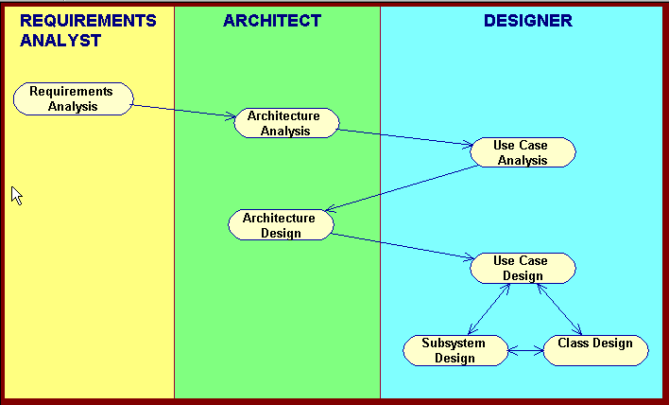
Basic RUP OOAD Activities
Notes:
ID Course Overview
REVIEW COURSE SCHEDULE--at least for the first weekend

Slide 3
Analysis Classes: A First Step Towards Executables
Use Cases
Analysis
Classes
Design
Elements
Source
Code
Exec
Use-Case Analysis
Notes:
ID Course Overview
Some of the work done in analysis is thrown away. This is not bad, since you need to play with the ideas to see what works and what doesn’t, but you should expect that much of the work done during analysis is a kind of ‘structured doodling’. The biggest mistakes happened when people assign too much value to the early results of analysis.
The need to define analysis classes in UML terms creates a sense that they are more formal than they are. An instructor once referred to analysis classes as “CRC-like
cards, on which you can scribble anything you want in the margins”.
This course concentrates on the development of a Design Model. Maintaining a separate Analysis Model would require some modifications to the presented activities, the discussion of which is out of the scope of this course.
REFERENCE: Rational! Good point to make, need to redo slide--I.e., language of the problem space vs solution space … first steps to solution space
Do a first try at a set of roles for achieving the goals of the use cases
Resulting set of classes are called analysis classes
Analysis classes together with proposed relationships represent an early conceptual model – represent things that have responsibilities and behavior
Analysis classes will get refined – represent clumps of behavior
Finding a candidate set of roles is the first step in the transformation of the system from a mere statement of required behavior to a description of how the system will work
The analysis classes, taken together, represent an early conceptual model of the system. This conceptual model evolves quickly and remains fluid for some time as different representations and their implications are explored. Formal documentation can impede this process, so be careful how much energy you expend on maintaining this ‘model’ in a formal sense; you can waste a lot of time polishing a model which is largely expendable. Analysis classes rarely survive into the design unchanged. Many of them represent whole collaborations of objects, often encapsulated by subsystems.
Analysis classes are 'proto-classes', which are essentially "clumps of behavior". These analysis classes are early conjectures of the composition of the system; they rarely survive intact into implementation. Many of the analysis classes morph into something else later on (subsystems, components, split classes, combined classes). They provide us with a way of capturing the required behaviors in a form that we can use to explore the behavior and composition of the system. Analysis classes allow us to "play" with the distribution of responsibilities, re-allocating, as necessary.
levi:
update

Slide 4
Use-Case Analysis Steps
Refine the use-case description
Model behavior using a sequence diagram
  Identify analysis classes for the use-case
  Model object collaborations
Model structure in VOPC diagram
  Capture responsibilities from sequence diagram
  Add analysis-level attributes and associations
  Note analysis mechanisms
Integrate analysis classes
Document business rules
J203-6, Q73-4
Notes:
ID Course Overview
The purpose of ‘Supplement the Descriptions of the Use-Case’ is to capture additional information needed in order to understand the required internal behavior of the system that may be missing from the use-case description written for the customer of the system. This information will be used as input to the rest of the steps in Use-Case Analysis and is used to assist in the allocation of responsibility.
Note: In some cases, we may find that some requirements were incorrect or not well-understood. In those cases, the original use-case flows of events should be updated (e.g., iterate back to the Requirements workflow).

Slide 5
Refine Use-Case Description
Display
Course
Offerings
Display
Course
Offerings
Refined Use Case
Original Use Case
...
...
...
The system retrieves a list of current course offerings from the course catalog legacy database
...
The system displays a list of course offerings
...
...
J204
Notes:
ID Course Overview
One technique for capturing this additional detail if Word is used to document the use cases is to add the detail in the form of comments in the Word document. That way the detail can be “turned on or off”, depending on the audience.
The description of each use case is not always sufficient for finding analysis classes and their objects. The customer generally finds information about what happens inside the system uninteresting, so the use-case descriptions may leave such information out. In these cases, the use-case description reads like a ‘black-box’ description, in which internal details on what the system does in response to an actor’s actions is either missing or very summarily described. To find the objects which perform the use case, you need to have the ‘white box’ description of what the system does from an internal perspective.
For example, in the case of the Course Registration System, the student may prefer to say ”the system displays a list of course offerings”. While this may be sufficient for the student, it gives us no real idea of what really happens inside the system. In order to form an internal picture of how the system really works, at a sufficient level of detail to identify objects, we may need additional information.
Taking the Register for Courses use case as an example, the expanded description would read as: "The system retrieves a list of current course offerings from the course catalog legacy database.” This level of detail gives us a clear idea of what information is required and who is responsible for providing the information.

Slide 6
Use-Case Analysis Steps
Refine the use-case description
Model behavior using a sequence diagram
  Identify analysis classes for the use-case
  Model object collaborations
Model structure in VOPC diagram
  Capture responsibilities from sequence diagram
  Add analysis-level attributes and associations
  Note analysis mechanisms
Integrate analysis classes
Document business rules
Notes:
ID Course Overview
This is where we preview what we will be doing in Use-Case Analysis
REFERENCE: see objectives slide
The above are the major steps of the Use-Case Analysis activity.
We first must review the use-case descriptions, as developed in the Requirements workflow. Chances are, they will need some enhancements to include enough detail from which an analysis model can begin to be developed.
Then, the use-case flows of events will be studied, analysis classes will be identified, and use-case responsibilities allocated to those analysis classes. Based on those allocations, and the analysis class collaborations, we can begin to model the relationships between those analysis classes.
Once the use case has been analyzed, we need to take a good look at the identified classes, making sure they are thoroughly documented, including the identification of which analysis mechanisms they will implement. And, last, but not least, we need to make sure that our developed analysis model is consistent.

Slide 7
Analysis Classes
Represent high level abstractions of one or more classes and/or subsystems
Emphasize functional requirements
Capture behavior in terms of conceptual responsibilities
Model attributes at high level
Categorize in terms of three “stereotypes”: entity, boundary, control
Q57-9, J181-5, J204-5
Notes:
ID Course Overview
This is where we preview what we will be doing in Use-Case Analysis
REFERENCE: p 181-182 jacobson

Slide 8
3 Analysis Class “Stereotypes”
Use-case behavior coordination
System information
System boundary
<<entity>>
<<boundary>>
<<control>>
Account
Cashier Interface
Withdrawal
Cashier Interface
Withdrawal
Account
Analysis classes : things in the system which have responsibilities, data, and behavior
Analysis classes are used to capture a ‘first-draft’, rough-cut of the object model of the system
Analysis classes model objects from the problem domain.
Analysis classes can be used to represent the objects we want the system to support
J183
Notes:
ID Course Overview
Entity classes are derived from the domain of the system. Boundary and control classes are ideal classes that are needed to describe the use cases inside the system.
Introducing the concepts of boundary and control classes in analysis and utilizing their canned responsibilities has provided a little of a “cook book” approach that some designers have been asking for. However, these class stereotypes can be misused. Proper usage of these concepts will be discussed on later slides.
The purpose of the distinction between the different types of analysis classes was to think about the roles objects play, and making sure the behavior is allocated according to the forces which cause objects to change. Once these forces have been considered and there is a good class decomposition, the distinction is no longer really useful.
All analysis classes do not have to have a stereotype. Just use the analysis class stereotypes when they help you. Don't feel that every analysis class you identify must have a stereotype (but make sure you qualify its existence).
REFERENCE: jacobson 183
ANIMATION: first labels, then descriptoins, then icons
Analysis classes -- ‘things in the system which have responsibilities and behavior’
Analysis classes are used to capture a ‘first-draft’, rough-cut of the object model of the system
3. Analysis classes model objects from the problem domain.
4. Analysis classes can be used to represent "the objects we want the system to support"
Analysis classes represent an early conceptual model for ‘things in the system which have responsibilities and behavior’. Analysis classes are used to capture a ‘first-draft’, rough-cut of the object model of the system.
Analysis classes handle primarily functional requirements, and model objects from the problem domain. Analysis classes can be used to represent "the objects we want the system to support," without making a decision on how much of them to support with hardware and how much with software.
There are three aspects of the system that are likely to change: the boundary between the system and its actors, the information the system uses, and the control logic of the system. In an effort to isolate the parts of the system that will change, different types of analysis classes are identified, each with a “canned” set of responsibilities: boundary, entity and control classes. Stereotypes may be defined for each type. These distinctions are used during analysis, but disappear in design.
The different types of analysis classes can be represented using different icons or with the name of the stereotype in guillemets (<< >>): <<boundary>>, << control>>, <<entity>>.
Each of these types of analysis classes are discussed on the following slides.

Slide 9
Boundary Classes
Capture interaction between system and actors (external systems)
Help isolate changes to external systems
Typical examples
  User interfaces
  System interfaces
  Device interfaces
Guideline: One boundary class per actor/use-case pair
Cashier Interface
Legacy Database
Plotter Interface
J183-4
Notes:
ID Course Overview
A boundary class intermediates the interface to something outside the system. Boundary class insulate the system from changes in the surroundings (changes in interfaces to other systems, changes in user requirements, etc.), keeping these changes from affecting the rest of the system.
A system may have several types of boundary classes:
User interface classes - Classes which mediate communication with human users of the system.
System interface classes - Classes which mediate communication with other systems. A boundary class which communicates with an external system is responsible for managing the dialogue with the external system; it provides the interface to that system for the system being built.
Device interface classes - Classes which provide the interface to devices which detect external events. These boundary classes capture the responsibilities of the device or sensor.
One recommendation for the initial identification of boundary classes is one boundary class per actor/use-case pair.

Slide 10
Boundary Classes Isolate System/Actor Interactions
librarian
BookCatalogDatabase
(from Use Case View)
(from Use Case View)
<<boundary>>
<<control>>
<<boundary>>
<<entity>>
<<entity>>
J183-4
Notes:
ID Course Overview
models interaction between the system's surroundings and its inner workings. Example: User Interface, or communication protocol.
Entity classes and control classes model the parts that are independent of the system's surroundings. Thus, changing the GUI or communication protocol should mean changing only the boundary classes, not the entity and control classes.
3. Actors can only communicate with boundary classes.
4. Boundary classes clarify the system's boundaries.
5. They aid design by providing a good point of departure for identifying related services. For example, if you identify a printer interface early in the design, you will soon see that you must also model the formatting of printouts.
Boundary clases model the parts of the system that depend on its actors, implying that they clarify and collect the requirements on the systems boundaries. Thus, a change in a user interface or in a communication interface is usually isolated in one or more boundary classes. Jacobson, p183.

Slide 11
Identify Boundary Classes
For each actor/use case pair
Check-out books
librarian
BookCatalog Database
<<boundary>>
<<boundary>>
CheckoutForm
BookCatalogDatabase
J183, J204-5
Notes:
ID Course Overview
The goal of analysis is to form a good picture of how the system is composed, not to design every last detail. In other words, identify boundary classes only for phenomena in the system or for things mentioned in the flow of events of the use-case realization.
Consider the source for all external events and make sure there is a way for the system to detect these events.
One recommendation for the initial identification of boundary classes is one boundary class per actor/use-case pair. This class can be viewed as having responsibility for coordinating the interaction with the actor. This may be refined as a more detailed analysis is performed. This is particularly true for window-based GUI applications, where there is typically one boundary class for each window, or one for each dialog.
In the above example:
The RegisterForCoursesForm contains a Student's "schedule-in-progress". It displays a list of Course Offerings for the current semester from which the Student may select to be added to his/her Schedule.
The CourseCatalogSystem interfaces with the legacy system that provides the unabridged catalog of all courses offered by the university. This class replaces the CourseCatalog abstraction originally identified in Architectural Analysis.
REFERENCE: jacobson, p183

Slide 12
Boundary Class Guidelines
User Interface
  Focus on what information is presented
  UI details get worked out in design and implementation
  Typically represent as a single analysis class (rather than as many separate screens)
System and Device Interface
  Focus on what is needed to facilitate communication with external systems
  How to implement is worked out later
Describe “what” is to be achieved, not “how” to achieve it
J183
Notes:
ID Course Overview
Guidelines:
Don’t spend too much time on details.
For User Interface: Just indicate elements that obviously need to be there, because of environmental or use case constraints. In Design these boundary classes will be further refined.
For System and Device Interfaces: If the interface to an existing system or device is already well-defined, the boundary class responsibilities should be derived directly from the interface definition. If there is a working communication with the external system or device, make note of it for later reference during design.
REFERENCE: jacobson, p183

Slide 13
What is an Entity Class?
Key abstractions of the system
Analysis class stereotype
Glossary
<<entity>>
Use Case
Business-Domain Model
Architectural Analysis Abstractions
J184-5, Q57
Notes:
ID Course Overview
Typical examples of entity classes in a banking system are Account and Customer. In a network-handling system, examples are Node and Link.
Some entity classes may be modeled attributes. The use of attributes vs. separate classes will be discussed later in the module. Keep in mind the key OO concept encapsulation. Entity classes are not just data and structure. They also contain responsibilities.
Tto reduce confusion for those cases where you need to model information about an actor within the system, you may want to define a naming convention for naming the system classes that hold actor information. Some possibilities include (if we had an Employee class that we need to retain information for):
Employee and Employee (I.e. same name)
Employee and EmployeeInfo
EmployeeActor and Employee
EmployeeActor and EmployeeInfo
If you find “EmployeeActor” not very user-friendly, you can also try “EmployeeUser”.
Another option, instead of appending “info” to the class name, try “session” or “profile”.
Using the same name for both does not cause Rose any problems as Rose supports separate namespaces. Thus, we have used the “same name” approach in the OOAD course example and exercise.
Entity objects hold the data for the application – they flesh out Key Abstractions
Frequent sources of inspiration for entity classes are the:
Glossary (developed during requirements)
Business-domain model (developed during business modeling, if business modeling has been performed)
Use-case flow of events (developed during requirements)
Key abstractions (identified in Architectural Analysis)
3. Note: sometimes there is a need to model information about an actor within the system. This is not the same as modeling the actor (actors are external. by definition). These classes are sometimes called “surrogates”.
levi:
update

Slide 14

Entity Classes Model Persistent Information
Librarian
BookCatalogDatabase
(from Use Case View)
(from Use Case View)
<<boundary>>
<<control>>
<<boundary>>
<<entity>>
<<entity>>
Responsibilities: to store and manage information in the system
Hold and update information about events or a real-life object
Usually persistent
J184-5, Q57
Notes:
ID Course Overview
Entity classes represent stores of information in the system; they are typically used to represent the key concepts the system manages. Entity objects (instances of entity classes) are used to hold and update information about some phenomenon, such as an event, a person, or some real-life object. They are usually persistent, having attributes and relationships needed for a long period, sometimes for the life of the system.
The main responsibilities of entity classes are to store and manage information in the system.
An entity object is usually not specific to one use-case realization; sometimes, an entity object is not even specific to the system itself. The values of its attributes and relationships are often given by an actor. An entity object may also be needed to help perform internal system tasks. Entity objects can have behavior as complicated as that of other object stereotypes. However, unlike other objects, this behavior is strongly related to the phenomenon the entity object represents. Entity objects are independent of the environment (the actors).
REFERENCE: jacobson 184

Slide 15

Finding Entity Classes by Filtering Use-Case Nouns
Start with key abstractions
Noun clauses in UC descriptions
  Ignore redundant or vague candidates
  Ignore actors (out of scope)
  Don’t introduce implementation constructs
  Things acted on by business rules
J184-5, J204, Q57
Notes:
ID Course Overview
Taking the use case flow of events as input, underline the noun phrases in the flow of events. These are the initial candidate list of analysis classes. Then go through a series of filtering steps where some candidate classes are eliminated. This is necessary due to the ambiguity of the English language. The result of the filtering exercise is a list of candidate entity classes.
While the filtering approach does add some structure to what could be an ad-hoc means of identifying classes, people generally filter as they go rather than blindly accepting all nouns and then filtering.
k levi:
walk through the
checkout book uc with
class before showing next
slide

Slide 16
Library System Problem Statement
You have been hired by Prince University to update their library record keeping. Currently the library has an electronic card catalog that contains information such as author, title, publisher, description, and location of all of the books in the library. All the library member information and book check-in and checkout information, however, is still kept on paper. This system was previously workable, because Prince University had only a few hundred students enrolled. Due to the increasing enrollment, the library now needs to automate the check-in/checkout system.
The new system will have a windows-based desktop interface to allow librarians to check-in and checkout books.
All books in the library have a unique bookid.The books in the library are ordered on the shelves by their bookid. The new system must allow library members to search through the electronic card catalog to find the bookid of the desired book.
The system will run on a number of individual desktops throughout the library. Librarians will have their own desktop computers that are not accessible by library members. Only librarians are able to check-in and checkout books.
The system will retain information on all library members. Only university students, faculty and staff can become library members. Students can check-out books for a maximum of 21 days. If a student returns a book later than 21 days, then he/she has to pay an overdue fee of 25 cents per day. University staff can also checkout books for a maximum of 21 days, but pay an overdue fee of 10 cents per day. Faculty can checkout books for a maximum of 100 days, and pay only 5 cents per day for every book returned late. The system will keep track of the amount of money that library members owe the library.
Notes:
ID Course Overview
You are hired by Prince University to build a new library system. Currently the library has a Book Catalog Database which contain all the information of the books in the library. All the library member information and book check-in and check-out information is kept on paper. This system was possible, because Prince University has only 100 students enrolled. Due to the increasing enrollment, the library needs a new system.
The new system will have a windows-based desktop interface to allow librarians to check-in and check-out books.
All books in the library have a unique bookid. The books in the library are ordered on the shelves on their bookid. The new system allows library members to search through the book catalog to find the bookid of the desired book.
The system will run on a number of individual desktops throughout the library. Librarians have their own desktop that are not accessible by library members. Only librarians are able to check-in and check-out books. This way the system does not need login functionality.
The system will retain information on all library members. Only university students, faculty and staff can become library members. Students can check-out books for a maximum of 21 days. If the student returns a book later than 21 days, then he/she has to pay an overdue fee of 25 cents per day. University staff can also check-out books for a maximum of 21 days, but pay an overdue fee of 10 cents per day. Faculty can check-out books for a maximum of 100 days, and pay only 5 cent per day for every book that is returned too late. The system keeps track of the amount of money that library members owe the library.
The library is on a very tight budget and has only one copy of every book. The new system must work with the existing Book Catalog Database. The new system does not need functionality to add, edit and delete books.

Slide 17
Example: Find Entity Classes
Check-out book
LibraryMember
CheckoutRecord
Book
Question: Why is LibraryMember considered an Entity class but not CardCatalog?
J184-5, J204, Q57
Notes:
ID Course Overview
The following are the definitions for each of the classes shown in the above diagram:
CourseOffering - A specific offering for a course, including days of the week and times.
Schedule - The courses a student has selected for the current semester.
Student - A person enrolled in classes at the university.
As mentioned earlier, sometimes there is a need to model information about an actor within the system. This is not the same as modeling the actor (actors are external. by definition). These classes are sometimes called “surrogates”.
For example, a course registration system maintains information about the student which is independent of the fact that the student also plays a role as an actor of the system. This information about the student that is stored in a ‘Student’ class is completely independent of the ‘actor’ role the student plays; the Student class will exist whether or not the student is an actor to the system.
If your students are new at this, you may want to go through an explicit “noun filtering” exercise with them, rather than just showing them the entity classes on this slide (i.e., go through the Register for Courses use case and underline the nouns, filtering out the ones that are not applicable for classes).
REFERENCE: schneider p30-31
animation: have course screen be added after students read example (the s-1 subflow)

Slide 18
Control Classes
Represent coordination and sequencing among groups of objects
Encapsulate control of individual use-cases
Guideline: One control class per use case
Control classes provide behavior that:
  Defines control logic (order between events) within a use case. Changes little if the internal structure or behavior of the entity classes changes
  Uses or sets the contents of several entity classes, and therefore needs to coordinate the behavior of these entity classes
J185, J205, Q58-9
Notes:
ID Course Overview
One recommendation for the initial identification of control classes is one control class per use-case. This may be refined as a more detailed analysis is performed.
Control classes are to be used to isolate use-case-specific responsibilities/behavior, not to be “do-all, be-all” classes. Control classes contain behavior that doesn’t belong in entity and boundary classes.
Stress that the control classes know how to “orchestrate and delegate”. They don’t do everything, but they know the order in which things should be done. In many cases, these control classes are “designed away” in Class Design (e.g., may become methods in UI classes). In analysis, however, they allow the analyst to allocate that use-case-specific behavior and move on.
REF: jacobson p185
??environment independent--should be “service” for boundary classes; I.e., should try to have boundary classes know about control, but not vice versa--I.e., control classes should return info based on requests to boundary classes, but not send messages to boundary classes. ??
Control classes provide coordinating behavior in the system. The system can perform some use cases without control classes (just using entity and boundary classes) - particularly use cases that involve only the simple manipulation of stored information. More complex use cases generally require one or more control classes to coordinate the behavior of other objects in the system. Examples of control classes include transaction managers, resource coordinators and error handlers.
Control classes effectively decouple boundary and entity objects from one another, making the system more tolerant of changes in the system boundary. They also decouple the use-case specific behavior from the entity objects, making them more reusable across use cases and systems.
Control classes provide behavior that:
Is surroundings-independent (does not change when the surroundings change)
Defines control logic (order between events) and transactions within a use case. Changes little if the internal structure or behavior of the entity classes changes
Uses or sets the contents of several entity classes, and therefore needs to coordinate the behavior of these entity classes
Is not performed in the same way every time it is activated (flow of events features several states)
One recommendation for the initial identification of control classes is one control class per use case.

Slide 19
Control Class as Use-Case Coordinator
librarian
BookCatalogDatabase
(from Use Case View)
(from Use Case View)
<<boundary>>
<<control>>
<<boundary>>
<<entity>>
<<entity>>
Note: Not always necessary for a use-case realization to contain a control class. Sometimes control is better encapsulated in a boundary class.
J185, J205, Q58-9
Notes:
ID Course Overview
A control class is a class used to model control behavior specific to one or more use cases. Control objects (instances of control classes) often control other objects, so their behavior is of the coordinating type. Control classes encapsulate use-case-specific behavior.
The behavior of a control object is closely related to the realization of a specific use case. In many scenarios, you might even say that the control objects "run" the use-case realizations. However, some control objects can participate in more than one use-case realization if the use-case tasks are strongly related. Furthermore, several control objects of different control classes can participate in one use case. Not all use cases require a control object. For example, if the flow of events in a use case is related to one entity object, a boundary object may realize the use case in cooperation with the entity object. You can start by identifying one control class per use-case realization, and then refine this as more use-case realizations are identified and commonality is discovered.
J205--e.g., sometimes control better encapsulated within a boundary class, especially if the actor handles large parts of the control. In such cases the control class is not needed. In other cases if control is more complex, then may be better encapsulated in one or more control classes. KL 12.1.00
Control classes can contribute to understanding the system because they represent the dynamics of the system, handling the main tasks and control flows.
When the system performs the use case, a control object is created. Control objects usually die when their corresponding use case has been performed.

Slide 20
Introduce Control Classes
For each use case
Check-out books
Librarian
BookCatalog Database
RULE OF THUMB STARTING OUT: Introduce one control class per use case.
<<control>>
CheckoutController
J185, J205, Q58-9
Notes:
ID Course Overview
One recommendation is to identify one control class per use case. Each control class is responsible for orchestrating/controlling the processing that implements the functionality described in the associated use case.
In the above example, the RegistrationController <<control>> class has been defined to orchestrate the Register for Courses processing within the system.

Slide 21
Example: Analysis Classes
Check-out book
librarian
BookCatalogDatabase
<<boundary>>
CheckoutForm
<<control>>
CheckoutController
<<boundary>>
BookCatalogDatabase
<<entity>>
LibraryMember
<<entity>>
Book
<<entity>>
CheckoutRecord
J181-5, J204-5, Q57-9
Notes:
ID Course Overview
Note: This slide is a summary of all of the other example slides for this step.
The Part-Time Student and Full-Time Student classes have been omitted from the diagram for clarity.
Animation: have arrow appear after use case, then boundary classes, then entity classes, then contol

Slide 22
Use-Case Analysis Steps
Refine the use-case description
Identify analysis classes for the use-case
Model behavior using a sequence diagram
Model object collaborations
Model structure in VOPC diagram
  Capture responsibilities from sequence diagram
  Add analysis-level attributes and associations
  Note analysis mechanisms
Integrate analysis classes
Document business rules
J203-6, Q73-4
Notes:
ID Course Overview
This is where we preview what we will be doing in Use-Case Analysis
REFERENCE: see objectives slide
The above are the major steps of the Use-Case Analysis activity.
We first must review the use-case descriptions, as developed in the Requirements workflow. Chances are, they will need some enhancements to include enough detail from which an analysis model can begin to be developed.
Then, the use-case flows of events will be studied, analysis classes will be identified, and use-case responsibilities allocated to those analysis classes. Based on those allocations, and the analysis class collaborations, we can begin to model the relationships between those analysis classes.
Once the use case has been analyzed, we need to take a good look at the identified classes, making sure they are thoroughly documented, including the identification of which analysis mechanisms they will implement. And, last, but not least, we need to make sure that our developed analysis model is consistent.

Slide 23
Assign Use-Case Behavior to Classes
Assign all use case steps to the analysis classes.
<<boundary>>
BookCatalogDatabase
Check-out book
1. ...
2. ...
3. ...
<<boundary>>
CheckoutForm
4. Uc description
5....
6. ...
<<entity>>
CheckoutRecord
7. ...
8. ...
<<entity>>
Book
<<entity>>
LibraryMember
<<control>>
CheckoutController
J203-6, Q73-4
Notes:
ID Course Overview
Do you find classes or objects first? Some people naturally think in abstractions. They find classes first. Others think concretely. They find objects first and then abstract these objects into classes.
Note: RUP ships with a set of special icons to visually represent these different types of classes. We have chosen not to use the RUP stereotypes in this course (they served to be too much of a distraction to the students).

Slide 24
Assign Use-Case Behavior to Classes
For each flow of events
  Identify analysis classes
  Model use-case behavior in interaction diagrams
  Don’t model interactions between actors
Check-out book
1. ...
2. ...
3. ...
4. Uc description...
Sequence Diagrams
5....
6. ...
7. ...
8. ...
Communication Diagrams
J203-6, Q73-4
Notes:
ID Course Overview
This is where the initial use-case realizations are developed.
When identifying analysis classes and allocating use-case responsibilities, keep in mind the recommendations: One control class per use case, one boundary class per actor/use-case pair.
You can create an interaction diagram for each variant of a use case's flow of events.
The Rational Unified Process recommends the use of Collaboration Diagrams in Analysis. This is discussed in more detail on a later slide.
Business Modeling is addressed in the Rational Unified Process in the “Business Modeling” workflow.
You are done with Use-Case Analysis when you have allocated all the use-case responsibilities to something (e.g., analysis classes).
You can identify analysis classes responsible for the required behavior by stepping through the flow of events of the use case. In the previous step we outlined some classes, now it’s time to see exactly where they are applied in the use-case flow of events.
In addition to the identified analysis classes, the interaction diagram should show interactions of the system with its actors (the interactions should begin with an actor, since an actor always invokes the use case). If you have several actor instances in the same diagram, try keeping them in the periphery of the diagram.
Interactions BETWEEN actors should NOT be modeled. By definition, actors are external, and are out of scope of the system being developed. Thus, you do not include interactions between actors in your system model. If you need to model interactions between entities that are external to the system you are developing (e.g., the interactions between a customer and an order agent for an order processing system), those interactions are best included in a Business Model that drives the System Model.
Guidelines for how to distribute behavior to classes is described on the next slide.

Slide 25
Sequence Diagram Features
:Controller
:Entity
Object Lifeline
Hierarchical
Numbering
1: doSomething
1.1: doSomethingElse
Time
Message
Self-Call (reflexive)
Activation bar
F68-71
Notes:
ID Course Overview
A message from one object to another, indicates that the responsibility modeled by the message has been allocated to the receiving object’s class. A message can be unassigned, meaning that its name is a temporary string that describes the overall meaning of the message and is not the name of an operation of the receiving object. You can later assign the message by specifying the operation of the message's destination object. The specified operation will then replace the name of the message. Class operations are not formally defined until Class Design.
Note: To reduce information overload, we intentionally did not include all of the possible UML detail that can be use on sequence diagrams.
In Rose, focus of control and hierarchical messaging can be turned on and off. If you are EVER going to use these features, turn them on right away as Rose is not very forgiving if you turn them on later and need to adjust things. Also, a script can be attached to a particular message, so the script moves with the message.
REF: Fowler68 - 71
NOTE: perhaps have the “notations” appear as mention each one
A sequence diagram describes a pattern of interaction among objects, arranged in a chronological order; it shows the objects participating in the interaction and the messages they send.
An object is shown as a vertical dashed line called the "lifeline". The lifeline represents the existence of the object at a particular time. An object symbol is drawn at the head of the lifeline, and shows the name of the object and its class separated by a colon and underlined.
A message is a communication between objects that conveys information with the expectation that activity will ensue; a message is shown as a horizontal solid arrow from the lifeline of one object to the lifeline of another object. For a reflexive message, the arrow starts and finishes on the same lifeline. The arrow is labeled with the name of the message, and its parameters. The arrow may also be labeled with a sequence number.
Focus of control represents the relative time that the flow of control is focused in an object, thereby representing the time an object is directing messages. Focus of control is shown as narrow rectangles (activation bars) on object lifelines.
Hierarchical numbering bases all messages on a dependent message. The dependent message is the message whose focus of control the other messages originate in. For example, message 1.1 depends on message 1.
Scripts describe the flow of events textually.

Slide 26
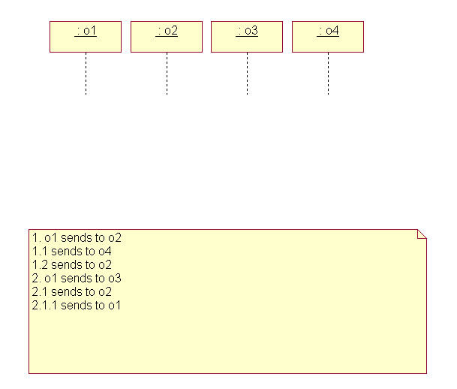
Example

Slide 27
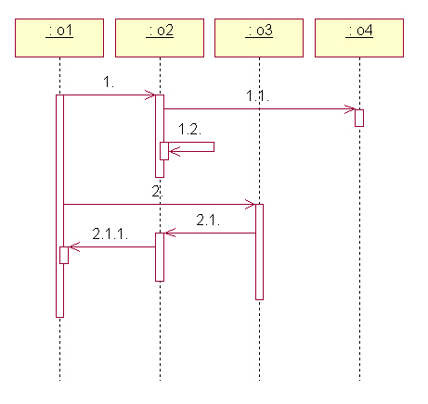
Example (cont)

Slide 28
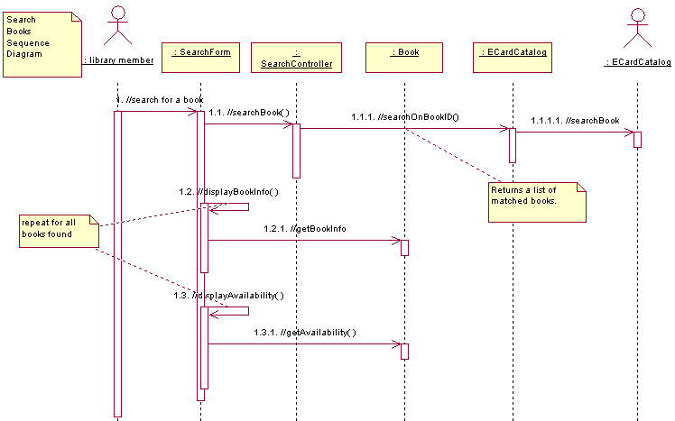
Example: Sequence Diagram
Notes:
ID Course Overview
Be sure to walk through this interaction diagram, emphasizing the responsibility allocation. Emphasize the application of the guidelines provided earlier.
Another option is to NOT show this slide immediately and to build the interaction diagram interactively with the students on the white board, demonstrating proper allocation of responsibility. When finished, you can compare the results with this slide.
Note: The use of “//” as the first two characters of the message name. This naming convention indicates that the operation is being used to describe the responsibilities of the analysis class and that these “analysis” operations WILL PROBABLY change/evolve in design).
k levi:
go through this quickly
on slide, then work
checkout book with
class--e.g., have them
start, then work out on
board? (make sure
have done on own first)

Slide 29
Diagram Scenarios vs Flows vs Use Case?
A scenario is a single pass
  Straightforward to create and read
  Full coverage infeasible
A flow is a set of similar scenarios
  Might involve conditions or loops
  Separate diagrams for significant flows
A use-case is the set of all flows
  In general, too complex for interaction diagrams
Notes:
ID Course Overview

Slide 30
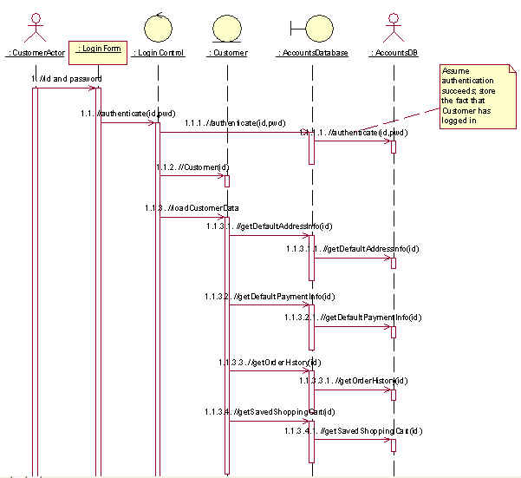
E-Bazaar Example of Sequence Diagram

Slide 31
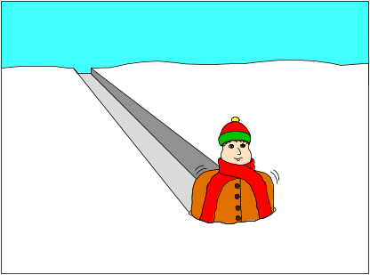

Analysis Class Stereotypes Guide Assignments
Boundary classes responsible for actor communications
Entity classes responsible for processing persistent information
Control classes responsible for use-case specific interactions or mediating other event flows
Q57-9, J181-5, J204-5
Notes:
ID Course Overview
The allocation of responsibilities in analysis is a crucial and sometimes difficult activity, and these stereotypes assist in that they provide a set of canned responsibilities that can be used to build a robust system by isolating the parts of the system that are most likely to change: the interface (boundary classes), the use-case flow-of-events (control classes) and the persistent data (entity classes).
NOTE: seems to me that the important point here is that it isolates parts of the system that are likely to change independently of each other, and therefore, isolating them from each other will facilitate reuse of the different parts--or isolating correlated changes to the different parts, … kl 11.29.00
REF 183-5 jacobson

Slide 32
Further Responsibility Assignment Guidelines
In general, class with the data should have the responsibility
If data is spread across classes
  Put the responsibility with one class and add a relationship to the other
  Create a new class, put the responsibility in the new class, and add relationships to classes needed to perform the responsibility
  Put the responsibility in the control class, and add relationships to classes needed to perform the responsibility
Notes:
ID Course Overview
A driving influence on where a responsibility should go is the location of the data needed to perform the operation.
The best case is that there is one class that has all the information needed to perform the responsibility. In that case, the responsibility goes with the data (after all, that’s one of the tenets of OO -- data and operations together).
If this isn’t the case, the responsibility may need to be allocated to a “third party” class that has access to the information needed to perform the responsibility. Classes and/or relationships may need to be created to make this happen. Be careful when adding relationships -- all relationships should be consistent with the abstractions they connect. Don’t just add relationships to support the implementation without considering the overall affect on the model. Class relationships will be discussed later in this module.
When a new behavior is identified, check to see if there is an existing class that has similar responsibilities, reusing classes where possible. Only when sure that there is not an existing object that can perform the behavior should you create new classes.
Ref to booch?
Good slide to introduce subsystems and clusters?
Last 3 subbullets still “rational”, redo.
keith levi:
ali additions/mods?

Slide 33
Collaboration Diagrams
Object
Link
1.1: doSomethingElse
:Controller
:Entity
1: doSomething
Message
A link is a relationship among objects across which a message can be sent
A message is a communication between objects that conveys information resulting in some activity – shown with a labeled arrow
Often use sequence numbers to label messages to keep track of the flow of events
F:72-4
Notes:
ID Course Overview
A collaboration diagram describes a pattern of interaction among objects; it shows the objects participating in the interaction by their links to each other and the messages that they send to each other.
An object is represented in three ways: Objectname:Classname, ObjectName, and :ClassName.
A link is a relationship among objects across which messages can be sent. In collaboration diagrams, a link is shown as a solid line between two objects. An object interacts with, or navigates to, other objects through its links to these objects. A link can be an instance of an association, or it can be anonymous, meaning that its association is unspecified.
A message is a communication between objects that conveys information with the expectation that activity will ensue. In collaboration diagrams, a message is shown as a labeled arrow placed near a link. This means that the link is used to transport, or otherwise implement the delivery of the message to the target object. The arrow points along the link in the direction of the target object (the one that receives the message). The arrow is labeled with the name of the message, and its parameters. The arrow may also be labeled with a sequence number to show the sequence of the message in the overall interaction. Sequence numbers are often used in collaboration diagrams, because they are the only way of describing the relative sequencing of messages. A message can be unassigned, meaning that its name is a temporary string that describes the overall meaning of the message. You can later assign the message by specifying the operation of the message's destination object. The specified operation will then replace the name of the message.
A message from one object to another, indicates that the responsibility modeled by the message has been allocated to the receiving object’s class.
Note: Class operations are not formally defined until Class Design.
A comparison of Collaboration Diagrams and Sequence Diagrams is provided on a later slide.
In Rose, sequence diagrams can automatically be generated from collaboration diagrams and visa versa.

Slide 34
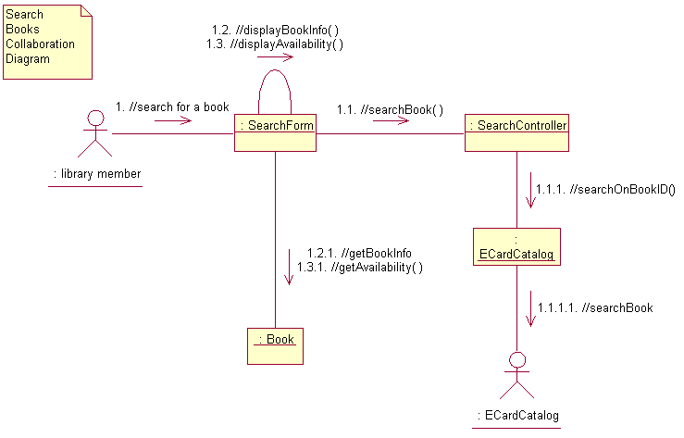
Example: Collaboration Diagram
Notes:
ID Course Overview
The above example shows the collaboration of objects to support the Register for Courses use case, Create a Schedule subflow. It is the “collaboration diagram equivalent” of the sequence diagram shown earlier.
Point out how the collaboration diagram makes it easy to see the patterns of collaboration amongst participating objects. For example, boundary class instances are “on the edge”, control class instances are “in the middle”, and entity class instances are “towards the bottom”. This reflects the roles of these class instances, as described earlier.

Slide 35
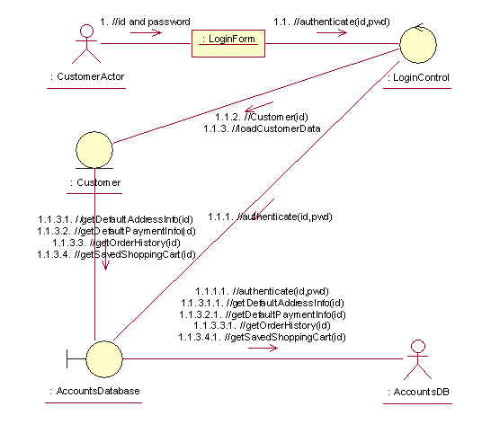
E-Bazaar Example of Collaboration Diagram

Slide 36
Sequence vs Collaboration Diagrams
Sequence Diagrams
  Show the explicit sequence of messages
  Better for visualizing overall flow
  Better for real-time specifications
Collaboration Diagrams
  Show relationships in addition to interactions (use for VOPC diagrams)
  Better for visualizing patterns of collaboration
  Better for visualizing all of the effects on a given object
F75, Q84
Notes:
ID Course Overview
The choice of sequence or collaboration diagrams is a personal choice. This course does not recommend one over the other, but describes the advantages of each.
For brainstorming, some find the collaboration diagram easier – a closer visual representation of CRC cards.
The students should use whichever diagram they like best, however, you may want to recommend that they ultimately create the collaboration diagram in support of finding relationships between the associated classes. Rose’s automatic generation of one diagram from the other makes this easy, no matter what diagram you start with.
Note: RUP recommends that collaboration diagrams be used in analysis and that sequence diagrams be used in design. Collaboration diagrams get pretty unwieldy in design.
Sequence diagrams and collaboration diagrams express similar information, but show it in different ways.
Collaboration diagrams emphasize the structural collaboration of a society of objects and provide a clearer picture of the patterns of relationships and control that exist amongst the objects participating in a use case. Collaboration diagrams show more structural information (i.e., the relationships among objects). Collaboration diagrams are better for understanding all the effects on a given object and for procedural design.
Sequence diagrams show the explicit sequence of messages and are better for real-time specifications and for complex scenarios. A sequence diagram includes chronological sequences, but does not include object relationships. Sequence numbers are often omitted in sequence diagrams, in which the physical location of the arrow shows the relative sequence. On sequence diagrams, the time dimension is easier to read, the operations and parameters are easier to present, and the larger number of objects are easier to manage than in collaboration diagrams.
Both sequence and collaboration diagrams allow you to capture semantics of the use-case flow of events; they help identify objects, classes, interactions, and responsibilities; and they help validate the architecture.

Slide 37
Use-Case Analysis Steps
Refine the use-case description
Model behavior using a sequence diagram
  Identify analysis classes for the use-case
  Model object collaborations
Model structure in VOPC diagram
  Capture responsibilities from sequence diagram
  Add analysis-level attributes and associations
  Note analysis mechanisms
Integrate analysis classes
Document business rules
J207 - 211
Notes:
ID Course Overview
This is where we preview what we will be doing in Use-Case Analysis
REFERENCE: see objectives slide
The above are the major steps of the Use-Case Analysis activity.
We first must review the use-case descriptions, as developed in the Requirements workflow. Chances are, they will need some enhancements to include enough detail from which an analysis model can begin to be developed.
Then, the use-case flows of events will be studied, analysis classes will be identified, and use-case responsibilities allocated to those analysis classes. Based on those allocations, and the analysis class collaborations, we can begin to model the relationships between those analysis classes.
Once the use case has been analyzed, we need to take a good look at the identified classes, making sure they are thoroughly documented, including the identification of which analysis mechanisms they will implement. And, last, but not least, we need to make sure that our developed analysis model is consistent.

Slide 38
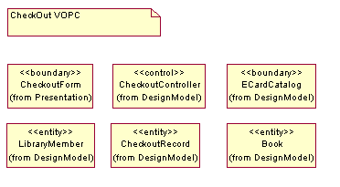
Building the VOPC Diagram
May use the Key Abstractions diagram as a starting point.
J186,Q85
Notes:
ID Course Overview
The VOPC provides a static view of the use-case realization, whereas the interaction diagrams provide a dynamic view. Looking at all of the classes participating in the use case can be helpful when assessing the consistency and overall responsibility allocation.
Emphasize that the use of slashes in the analysis class operation name (“//”) is a CONVENTION for identifying responsibilities.
Compare this with the sequence diagram on slide 35 and the collaboration diagram on slide 38. Each instance on that sequence diagram has a class on the VOPC.
The View of Participating Classes (VOPC) class diagram contains the classes whose instances participate in the use-case realization interaction diagrams, as well as the relationships required to support the interactions. We will discuss the relationships later in this module. Right now, we are most interested in what classes have been identified, and what responsibilities have been allocated to those classes.

Slide 39
Use-Case Analysis Steps
Refine the use-case description
Model behavior using a sequence diagram
  Identify analysis classes for the use-case
  Model object collaborations
Model structure in VOPC diagram
  Capture responsibilities from interaction diagram
  Add analysis-level attributes and relationships
  Note analysis mechanisms
Integrate analysis classes
Document business rules
J207-8, Q85
Notes:
ID Course Overview
This is where we preview what we will be doing in Use-Case Analysis
REFERENCE: see objectives slide
The above are the major steps of the Use-Case Analysis activity.
We first must review the use-case descriptions, as developed in the Requirements workflow. Chances are, they will need some enhancements to include enough detail from which an analysis model can begin to be developed.
Then, the use-case flows of events will be studied, analysis classes will be identified, and use-case responsibilities allocated to those analysis classes. Based on those allocations, and the analysis class collaborations, we can begin to model the relationships between those analysis classes.
Once the use case has been analyzed, we need to take a good look at the identified classes, making sure they are thoroughly documented, including the identification of which analysis mechanisms they will implement. And, last, but not least, we need to make sure that our developed analysis model is consistent.

Slide 40

Responsibilities from Collaboration Diagram
Responsibilities are specifications of object behavior
Collaboration Diagram
:Controller
:Entity
// doSomething
Responsibility, as an “analysis operation”
Class Diagram
Entity
// doSomething
Q105-8
Notes:
ID Course Overview
The goal is to get a sense of what the class does. This drives the definition of design elements in Architectural Design, the operations in Class Design, and can be used to determine whether classes should be split, combined, etc.
Analysis class responsibilities are essentially a first-cut of class operations.
That all objects can be created and deleted goes without saying; don’t restate the obvious unless the object performs some special behavior when it is created or deleted (some objects cannot be removed if certain relationships exist).
A responsibility is a statement of something an object can be asked to provide. Responsibilities evolve into one (or more) operations on classes in design; they can be characterized as:
The actions that the object can perform
The knowledge that the object maintains and provides to other objects
Responsibilities are derived from messages on interaction diagrams. For each message, examine the class of the object to which the message is sent. If the responsibility does not yet exist, create a new responsibility that provides the requested behavior.
Other responsibilities will derive from non-functional requirements. When you create a new responsibility, check the non-functional requirements to see if there are related requirements which apply. Either augment the description of the responsibility, or create a new responsibility to reflect this.
Analysis class responsibilities can be documented in one of two ways:
As “analysis” operations.
When this approach is chosen, it is important that some sort of naming convention be used. This naming convention indicates that the operation is being used to describe the responsibilities of the analysis class and that these “analysis” operations WILL PROBABLY change/evolve in design).
Textually, in the description of the analysis classes.
For the OOAD course example, we will use the “analysis” operation approach. The naming convention that will be used is that the “analysis” operation name will be preceded by '//'.

Slide 41
Guidelines for (re)Structuring Responsibilities and Classes
“Orthogonal” responsibilities within classes
  separate (e.g. //parseMessage and //displayMessage)
Redundant responsibilities across classes
  Integrate (e.g. two classes determining look of gui)
Each analysis class should have several compatible responsibilities. A class with only one responsibility is probably too simple
Q105
Notes:
ID Course Overview
Humorous example of disjoint responsibilities:
“Class A does this and makes peanut butter and jelly sandwiches”.
Be wary of a class that does everything.
Each analysis class should have several responsibilities; a class with only one responsibility is probably too simple, while one with a dozen or more is pushing the limit of reasonability and should potentially be split into several classes.
Make sure that the allocation of responsibilities is appropriate.
***ali--business rule guidelines here??**
Examine classes to ensure they have consistent responsibilities. When a class’s responsibilities are orthogonal, split the object into two or more classes. Update the interaction diagrams accordingly.
Examine classes to ensure that there are not two classes with similar responsibilities. When classes have similar responsibilities, combine them and update the interaction diagrams accordingly.
Sometimes you have to get back to a previous interaction diagram and redo it: a better distribution of behavior may have become evident while you were working on another interaction diagram. It is better (and easier) to change things now than later in design. Take the time to set the diagrams right, but don’t get hung-up trying to optimize the class interactions.
A class with only one responsibility is not a problem, per se, but it should raise questions on why it is needed. Be prepared to challenge and justify the existence of all classes.

Slide 42
Use-Case Analysis Steps
Refine the use-case description
Model behavior using a sequence diagram
  Identify analysis classes for the use-case
  Model object collaborations
Model structure in VOPC diagram
  Capture responsibilities from sequence diagram
  Add analysis-level attributes and relationships
  Note analysis mechanisms
Integrate analysis classes
Document business rules
J208-11
Notes:
ID Course Overview
This is where we preview what we will be doing in Use-Case Analysis
REFERENCE: see objectives slide
The above are the major steps of the Use-Case Analysis activity.
We first must review the use-case descriptions, as developed in the Requirements workflow. Chances are, they will need some enhancements to include enough detail from which an analysis model can begin to be developed.
Then, the use-case flows of events will be studied, analysis classes will be identified, and use-case responsibilities allocated to those analysis classes. Based on those allocations, and the analysis class collaborations, we can begin to model the relationships between those analysis classes.
Once the use case has been analyzed, we need to take a good look at the identified classes, making sure they are thoroughly documented, including the identification of which analysis mechanisms they will implement. And, last, but not least, we need to make sure that our developed analysis model is consistent.

Slide 43
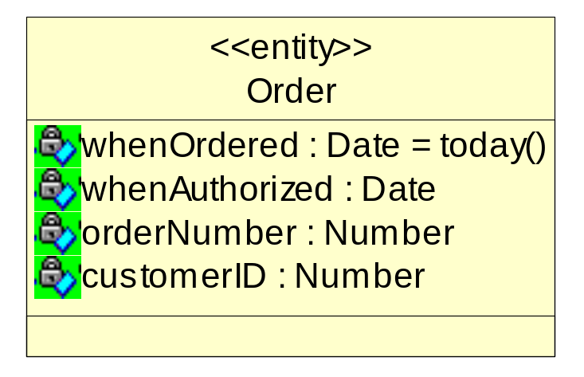
Attributes
A named property of a class that describes a range of values that instances of the property may hold.
  Types can be conceptual during analysis. E.g. ‘amount’ might become ‘integer’ or ‘double’ during design.
Information retained by identified classes
B50,R208
Notes:
ID Course Overview
Modeling relationships in analysis adds a lot of value for the following reasons:
It allows the analyst to model the structural/static relationships that support the domain and the actual definitions and responsibilities of the classes themselves, as well as the classes they collaborate with.
The multiplicity provides insight in application/business rules, especially the recognition that some relationships are optional.
In order to carry-out their responsibilities, classes frequently depend on other classes to supply needed behavior. Associations document the inter-class dependencies and help us to understand class coupling; better understanding of class coupling, and reduction of coupling where possible, can help us build better, more resilient systems.

Slide 44
Where To Find Attributes
Requirements: problem statement, set of system requirements, and flow of events documentation
Domain expert
“Nouns” that did not become classes
  Information whose value is the important thing
  Information that is uniquely "owned” by an object
  Information that has no behavior
  Note: Attributes are often realized as objects like instances of Date or List
Q110, J208-209
Notes:
ID Course Overview
Sources of possible attributes: domain knowledge, requirements, glossary, domain model, business model, etc.
Attributes are used instead of classes where :
Only the value of the information, not it's location, is important
The information is uniquely "owned" by the object to which it belongs; no other objects refer to the information
The information is accessed by operations which only get, set or perform simple transformations on the information; the information has no "real" behavior other than providing its value
If, on the other hand, the information has complex behavior, or is shared by two or more objects the information should be modeled as a separate class.
Attributes are domain dependent (an object model for a system, includes those characteristics that are relevant for the problem domain being modeled).
Remember, the process is use-case-driven. Thus, all discovered attributes should support at least one use case. For this reason, the attributes that are discovered are affected by what functionality/domain being modeled.

Slide 45
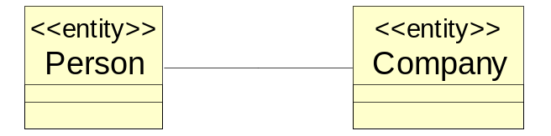
Review of Associations
An association models a structural relationship between objects
Reflexive Association
has relatives
Simple Association
<<entity>>
Person
B65-66, Q89
Notes:
ID Course Overview
Associations connect instances of two or more classes together for some duration (as opposed to a dependency relationship, which represents a temporary association between two instances).
Dependency relationships will be discussed in the Class Design module.
In this module, we are most interested in those associations that follow from the interaction diagrams. This is discussed in more detail on a later slide.
Do not use relationship names if they add no value/information to the model. Remember, readability and understandability of the model are key -- only add information that adds value, not clutter to the diagrams.
Note: In the OOAD course example, we did not use the relationship names shown in this example (we used role names). The above is included as an example.
This would be a good time to make sure that the students understand the difference between Course and CourseOffering and how Schedule fits in.
Associations represent structural relationships between objects of different classes, information that must be preserved for some duration and not simply procedural dependency relationships (e.g., one object has a permanent association to another object).
You can use associations to show that objects know about other objects. Sometimes, objects must hold references to each other to be able to interact, for example send messages to each other; thus, in some cases associations may follow from interaction patterns in sequence diagrams or collaboration diagrams.
Most associations are simple (exist between exactly two classes), and are drawn as solid paths connecting pairs of class symbols. Ternary relationships are also possible. Sometimes, a class has an association to itself. This does not necessarily mean that an instance of that class has an association to itself; more often, it means that one instance if the class has associations to other instances of the same class.
An association may have a name that is placed on, or adjacent to the association path. The name of the association should reflect the purpose of the relationship and be a verb phrase; the name of an association can be omitted, particularly if role names are used (see next slide).
Avoid names like "has" and "contains", as they add no information about what the relationships are between the classes.
In the above example, Students and CourseOfferings are related via the Schedule class. This is because in the Course Registration System, Schedule is a first class citizen. Students are enrolled in a CourseOffering if there is a relationship between the Student’s Schedule and the CourseOffering.

Slide 46
Review of Association Adornments
Name
Role
Multiplicity
Aggregation
B66
Notes:
ID Course Overview

Slide 47
Relationships from Collaboration Diagram
Create a relationship for each link
Collaboration
Diagram
:Controller
:Entity
1: doSomething
Class
Diagram
Entity
Controller
1
0..*
Prime suppliers
doSomething()
Association
Q98
Notes:
ID Course Overview
There are 2 sources of information for the relationships:
The use-case realizations (every object link results in an association), and
the domain (i.e., the data modeling of the entities).
In this module, we will be concentrating on the use-case realizations as a source of relationships.
Some of the associations discovered here may be refined into dependency relationships in Class Design. The “refinement of associations” is performed in Class Design because much of the knowledge needed to perform it involves internal class details.
To find relationships, start studying the links in the collaboration diagrams. Links between classes indicate that objects of the two classes need to communicate with one another to perform the use case. Thus, an association or an aggregation is needed between the associated classes (the difference between these relationship types and when to use which was discussed earlier).
Reflexive links do not need to be instances of reflexive relationships; an object can send messages to itself. A reflexive relationship is needed when two different objects of the same class need to communicate.
The navigability of the relationship should support the required message direction. In the above example, if navigability was not defined from the Client to the Supplier, then the PerformResponsibility message could not be sent from the Client to the Supplier.
Focus only on associations needed to realize the use cases; don't add association you think "might" exist unless they are required based on the interaction diagrams.
Remember to give the associations role names and multiplicities. You can also specify navigability, though this will be refined in Class Design.
Write a brief description of the association to indicate how the association is used, or what relationships the association represents.

Slide 48
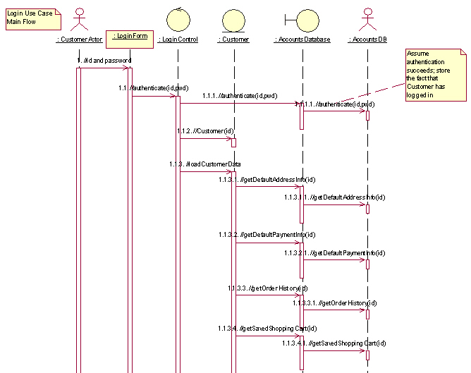
Example: Login Sequence Diag in EBazaar
Notes:
ID Course Overview
NOTEKL: this is the ucdesign diagram!!

Slide 49
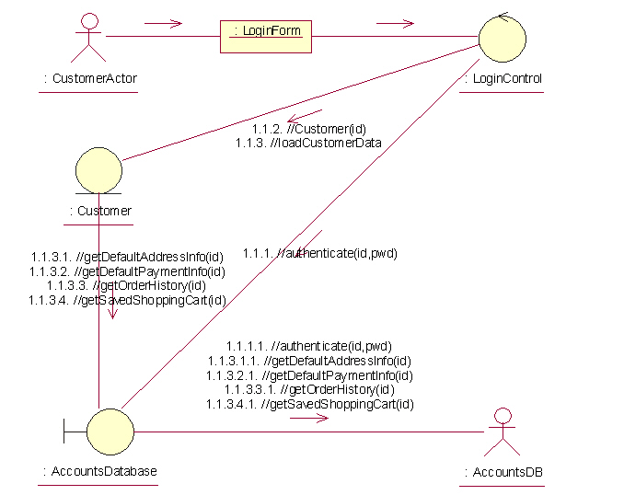
Example: Login Collab Diag in EBazaar
J186,Q85
Notes:
ID Course Overview
The VOPC provides a static view of the use-case realization, whereas the interaction diagrams provide a dynamic view. Looking at all of the classes participating in the use case can be helpful when assessing the consistency and overall responsibility allocation.
Emphasize that the use of slashes in the analysis class operation name (“//”) is a CONVENTION for identifying responsibilities.
Compare this with the sequence diagram on slide 35 and the collaboration diagram on slide 38. Each instance on that sequence diagram has a class on the VOPC.
The View of Participating Classes (VOPC) class diagram contains the classes whose instances participate in the use-case realization interaction diagrams, as well as the relationships required to support the interactions. We will discuss the relationships later in this module. Right now, we are most interested in what classes have been identified, and what responsibilities have been allocated to those classes.

Slide 50
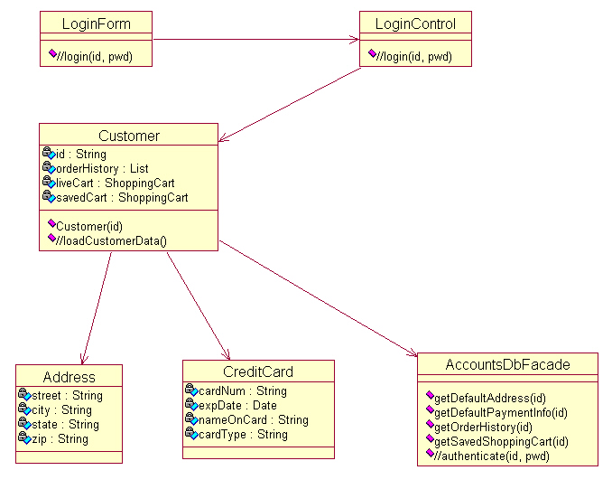
Example: Login VOPC in EBazaar
Notes:
ID Course Overview
Compare this with the collaboration diagram for the Register for Courses collaboration diagram on slide 38. Each instance on that sequence diagram has a class on the VOPC and each link has a relationship. Such a comparison also shows how easy it is to find relationships from collaboration diagrams.
Emphasize that the use of slashes in the analysis class operation name (“//”) is a CONVENTION for identifying responsibilities.
The diagram on this slide shows classes that collaborate to perform the “Register for Courses” use case, along with their relationships. Again, this diagram is called a View of Participating Classes (VOPC) diagram.
Note: The complete VOPC was too big to fit on a single slide, so some of the classes are shown above and the remaining appear on the next slide.
The relationships were defined based on the interaction diagrams for the “Register for Courses” use case provided earlier in this module.
Rationale for relationships:
From RegisterForCoursesForm to RegistrationController: There is one controller for each Schedule being created (e.g., each Student registration session).
From RegistrationController to CourseCatalogSystem: There’s only one CourseCatalogSystem instance for possibly many RegistrationControllers. This serializes access to the legacy system.
From RegistrationController to Student. A RegistrationController deals with one Student at a time (the Student currently registering for courses). Note the use of the “registrant” role name.
From RegistrationController to Schedule. A RegistrationController deals with one Schedule at a time (the current Schedule for the Student registering for courses). Note the use of the “currentSchedule” role name.
Note: Many RegisterForCoursesForms can be active at one time (for different sessions/students), each with their own RegistrationController.

Slide 51
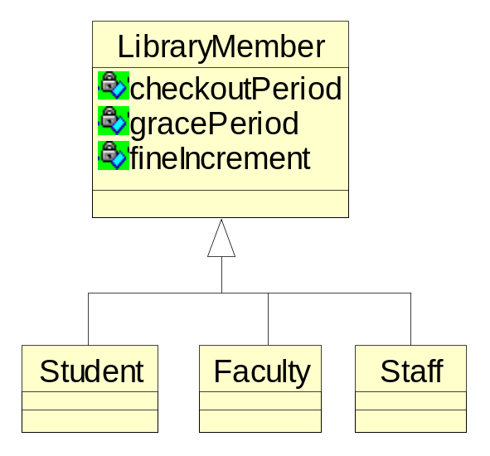
Review of Generalization
One class shares the attributes and/or behavior of one or more classes
“Is-a” relationship
In analysis, keep on conceptual level just to make model easier to understand
J210-211
Notes:
ID Course Overview
Generalization used in analysis should be so obvious from the abstraction definitions, that it “hits you in the head with a 2-by-4”.
NOTE: next 4 were originally 22-25 in rational
When identifying the analysis classes, especially the entity classes, inheritance relationships amongst the classes may be identified.
As discussed in the Introduction to Object Orientation, generalization is a relationship among classes where one class shares the structure and/or behavior of one or more classes.
Generalization refines a hierarchy of abstractions in which a subclass inherits from one or more superclasses.
Generalization is an “is-a-kind of” relationship. You should always be able to say that your generalized class ‘is a kind of’ the parent class.
In analysis, generalization should be used to model shared behavioral semantics only (i.e., generalization that passes the “is-a” test). Generalization to promote and support reuse will be defined in design. In analysis, the generalization should be used to reflect shared definitions/semantics and promote “brevity of expression” (i.e., the use of generalization makes the definitions of the abstractions easier to document and understand).
When generalization is found, a common super-class is created to contain the common attributes, associations, aggregations, and operations. The common behavior is removed from the classes which are to become sub-classes of the common super-class. A generalization relationship is drawn from the sub-class to the super-class.

Slide 52
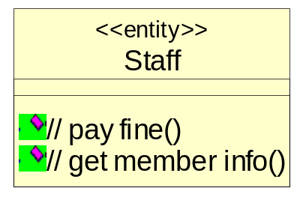
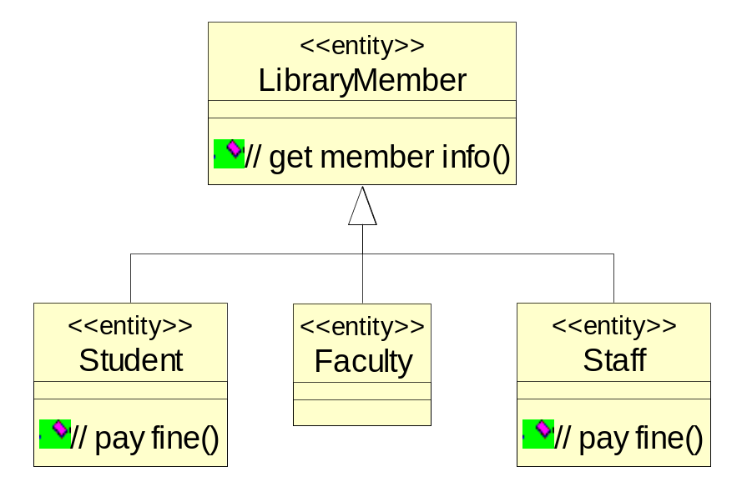
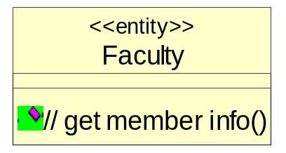
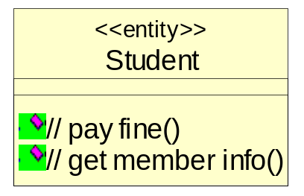
Finding Generalization: Generalization of Classes
Create superclasses which encapsulate structure and common behavior of several classes.
More general
Q210-211
Notes:
ID Course Overview
You may apply generalization when you have a set of classes that share some semantics and behavior. The shared semantics and behavior are included in the base class, the subclasses inherit from that base class, and the unique semantics and behavior are included in the subclasses.
General properties are placed in the upper part of the inheritance hierarchy, and special properties lower down.

Slide 53
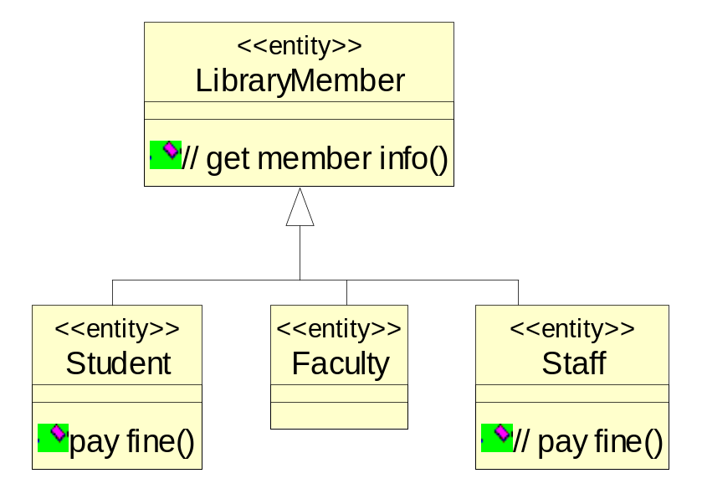
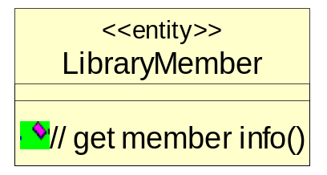
Finding Generalization: Specialization of Classes
Create subclasses that add refinements of the superclass
More specific
Q210-211
Notes:
ID Course Overview
You may apply generalization when you have a class with very general semantics and behavior, and you want to also model more specialized versions of the more general class. As with the previous example, the shared semantics and behavior are included in the base class, the subclasses inherit from the base class, and the unique semantics and behavior are included in the subclasses.
More specialized properties are placed in the lower part of the inheritance hierarchy.

Slide 54
Use-Case Analysis Steps
Refine the use-case description
Model behavior using a sequence diagram
  Identify analysis classes for the use-case
  Model object collaborations
Model structure in VOPC diagram
  Capture responsibilities from sequence diagram
  Add analysis-level attributes and associations
  Document analysis mechanisms
Document business rules
Integrate analysis classes
Notes:
ID Course Overview
This is where we preview what we will be doing in Use-Case Analysis
REFERENCE: see objectives slide
The above are the major steps of the Use-Case Analysis activity.
We first must review the use-case descriptions, as developed in the Requirements workflow. Chances are, they will need some enhancements to include enough detail from which an analysis model can begin to be developed.
Then, the use-case flows of events will be studied, analysis classes will be identified, and use-case responsibilities allocated to those analysis classes. Based on those allocations, and the analysis class collaborations, we can begin to model the relationships between those analysis classes.
Once the use case has been analyzed, we need to take a good look at the identified classes, making sure they are thoroughly documented, including the identification of which analysis mechanisms they will implement. And, last, but not least, we need to make sure that our developed analysis model is consistent.

Slide 55

Document Analysis Mechanisms
Map classes to mechanisms
Analysis Class
Analysis Mechanism(s)
J203
Notes:
ID Course Overview
The analysis mechanisms may be documented for a class using UML properties.
In Rose, they can also be included in the documentation field of the class.
In Architectural Analysis, the possible analysis mechanisms were identified and defined.
From that point on, as classes are defined, the required analysis mechanisms and analysis mechanism characteristics should be identified and documented. Not all classes will have mechanisms associated with them. Also, it is not uncommon for a client class to require the services of several mechanisms.
A mechanism has characteristics, and a client class uses a mechanism by qualifying these characteristics; this is to discriminate across a range of potential designs. These characteristics are part functionality, and part size and performance.

Slide 56
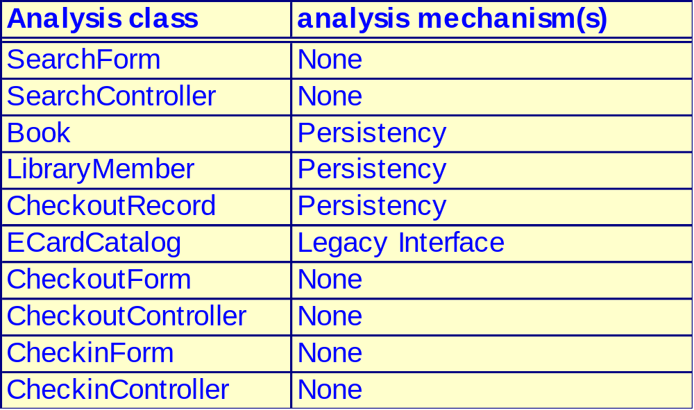
Example: Document Analysis Mechanisms
Notes:
ID Course Overview
As analysis classes are identified, it is important to identify the analysis mechanisms that apply to the identified classes.
The classes that must be persistent are mapped to the Persistency mechanism.
The classes that are maintained within the legacy Course Catalog system are mapped to the Legacy Interface mechanism.
The classes for which access must be controlled (i.e., control who is allowed to read and modify instances of the class) are mapped to the Security mechanism. Note: The Legacy Interface classes do not require additional security as they are read-only and are considered readable by all.
The classes that are seen to be distributed are mapped to the Distribution mechanism. The distribution identified during analysis is that which is specified/implied by the user in the initial requirements. Distribution will be discussed in detail in the Describe Distribution module. For now, just take it as an architectural given that all control classes are distributed for the OOAD course example and exercise.

Slide 57
Use Case Analysis steps
Supplement the Use Case Descriptions
For each use case realization, find classes and distribute use case behavior to classes
Model the analysis classes with
  Sequence diagrams to show the flow of the application
  Collaboration diagrams to suggest relationships
  VOPC diagrams to specify static relationships and to elaborate attributes of each class

Slide 58
Use-Case Analysis Review
What is done during Use Case analysis?
What is a use-case realization?
What are the input and output artifacts of Use-Case Analysis?
What is an analysis class? Describe the three analysis stereotypes.
What are the dynamic and static aspects of use case analysis?
How many sequence diagrams should be produced during Use-Case Analysis?
Notes:
ID Course Overview

